Slide 1
RIP version 1
Routing Protocols and Concepts – Chapter 5

Slide 2
Objectives
Describe the functions, characteristics, and operation of the RIPv1 protocol.
Configure a device for using RIPv1.
Verify proper RIPv1 operation.
Describe how RIPv1 performs automatic summarization.
Configure, verify, and troubleshoot default routes propagated in a routed network implementing RIPv1.
Use recommended techniques to solve problems related to RIPv1

Slide 3
RIPv1
RIP Characteristics
-A classful, Distance Vector (DV) routing protocol
-Metric = hop count
-Routes with a hop count > 15 are unreachable
-Updates are broadcast every 30 seconds

Slide 4
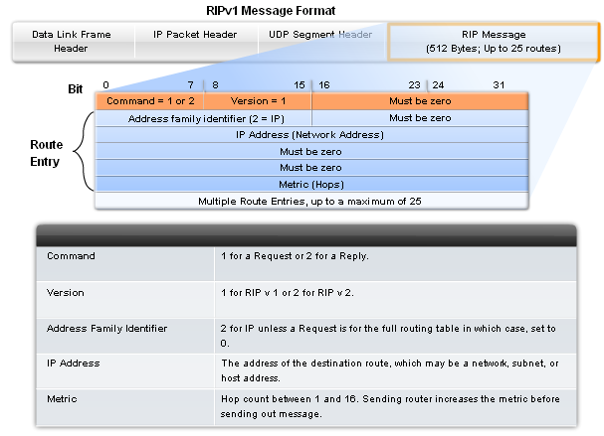
RIPv1
RIP Message Format
RIP header - divided into 3 fields
-Command field
-Version field
-Must be zero
Route Entry - composed of 3 fields
  -Address family identifier
  -IP address
  -Metric

Slide 5
RIPv1
RIP Operation
  RIP uses 2 message types:
      Request message
-This is sent out on startup by each RIP enabled interface
-Requests all RIP enabled neighbors to send routing table
      Response message
-Message sent to requesting router containing routing table

Slide 6
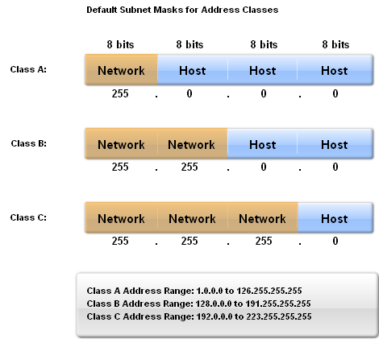
RIPv1
IP addresses initially divided into classes
-Class A
-Class B
-Class C
RIP is a classful routing protocol
-Does not send subnet masks in routing updates

Slide 7
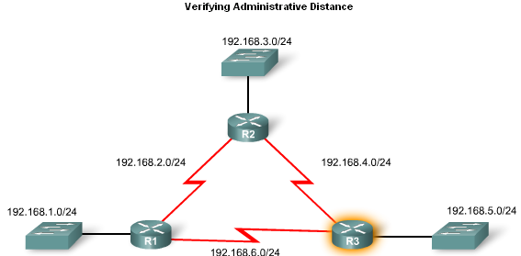
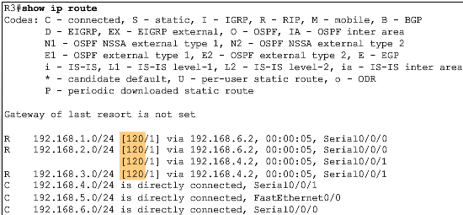
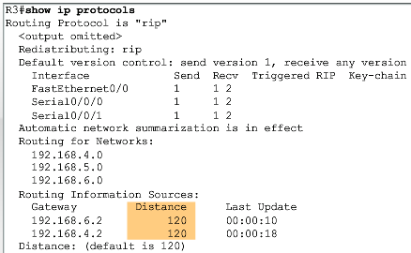
RIPv1
Administrative Distance
  RIP’s default administrative distance is 120

Slide 8
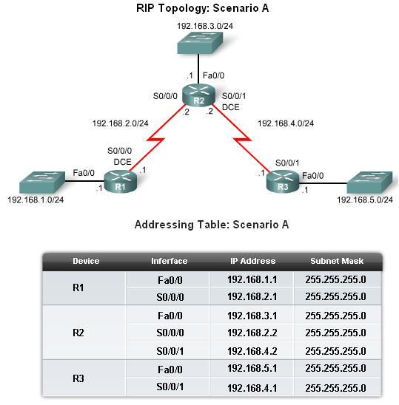
Basic RIPv1 Configuration
A typical topology suitable for use by RIPv1 includes:
    -Three router set up
    -No PCs attached to LANs
-Use of 5 different IP subnets

Slide 9
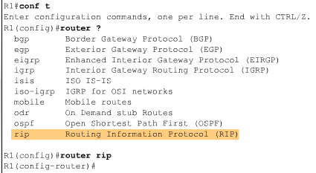
Basic RIPv1 Configuration
Router RIP Command
  To enable RIP enter:
  -Router rip at the global configuration prompt
  -Prompt will look like R1(config-router)#

Slide 10
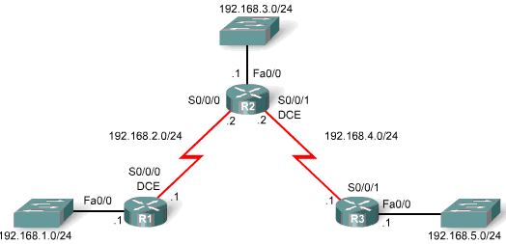
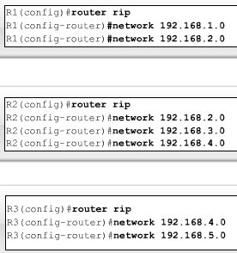
Basic RIPv1 Configuration
Specifying Networks
  Use the network command to:
  -Enable RIP on all interfaces that belong to this network
  -Advertise this network in RIP updates sent to other routers every 30 seconds

Slide 11
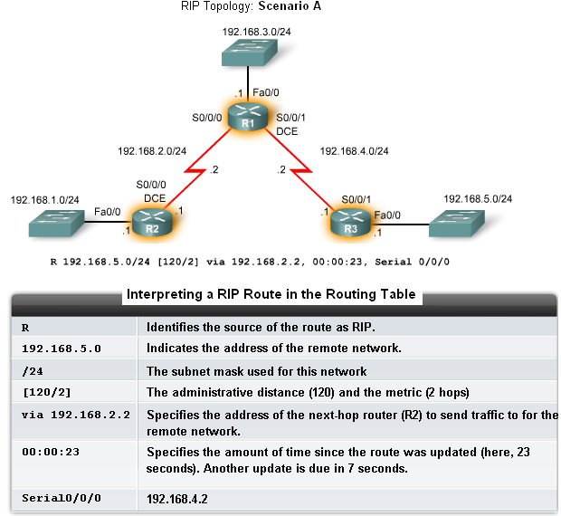
Verification and Troubleshooting
Show ip Route
To verify and troubleshoot routing
-Use the following
commands:
-show ip route
-show ip protocols
-debug ip rip

Slide 12
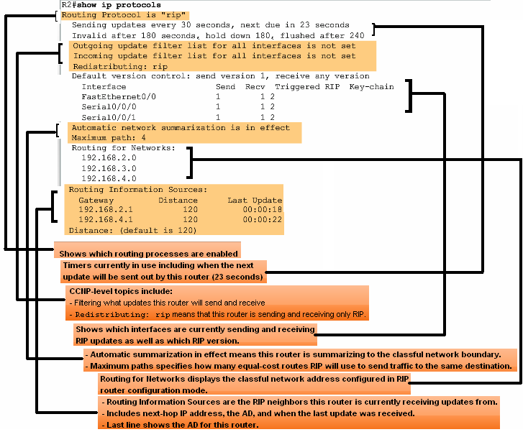
Verification and Troubleshooting
show ip protocols command
-Displays routing protocol configured on router

Slide 13
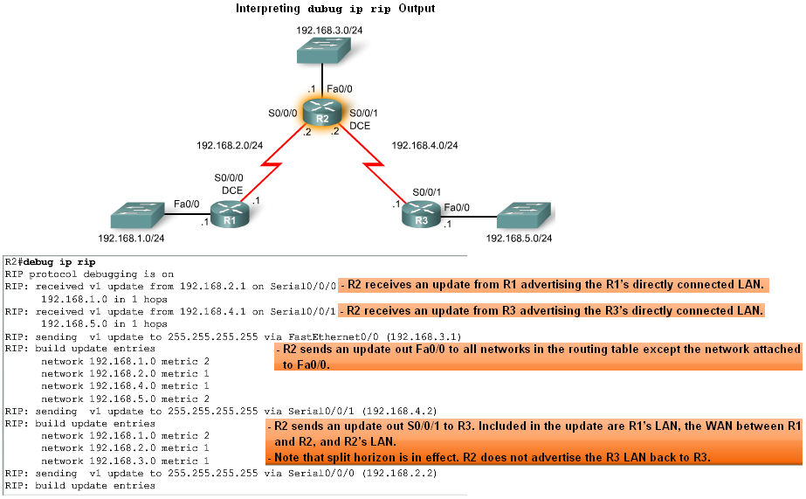
Verification and Troubleshooting
Debug ip rip command
-Used to display RIP routing updates as they are happening

Slide 14
Verification and Troubleshooting
Passive interface command
-Used to prevent a router from sending updates through an interface
-Example:
Router(config-router)#passive-interface interface-type interface-number

Slide 15
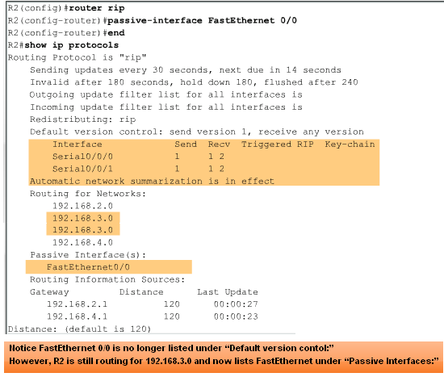
Verification and Troubleshooting
Passive interfaces

Slide 16
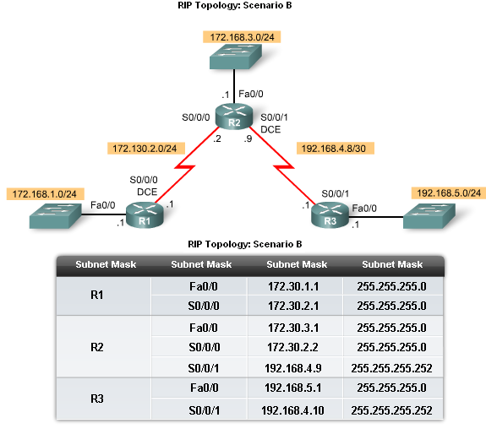
Automatic Summarization
Modified Topology
The original scenario has been modified such that:
Three classful networks are used:
172.30.0.0/16
192.168.4.0/24
192.168.5.0/24
The 172.30.0.0/16 network is subnetted into three subnets:
172.30.1.0/24
172.30.2.0/24
172.30.3.0/24
The following devices are part of the 172.30.0.0/16 classful network address:
All interfaces on R1
S0/0/0 and Fa0/0 on R2

Slide 17
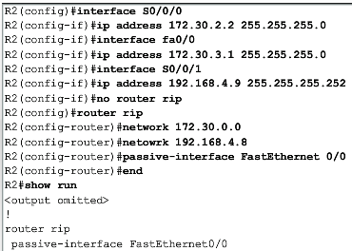
Automatic Summarization
Configuration Details
-To remove the RIP routing process use the following command
No router rip
-To check the configuration use the following command
Show run

Slide 18
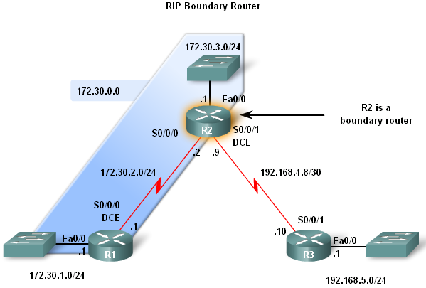
Automatic Summarization
Boundary Routers
  RIP automatically summarizes classful networks
  Boundary routers summarize RIP subnets from one major network to another.

Slide 19
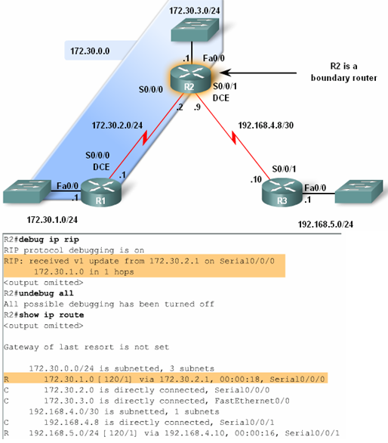
Automatic Summarization
Processing RIP Updates
2 rules govern RIPv1 updates:
-If a routing update and the interface it’s received on belong to the same network then
The subnet mask of the interface is applied to the network in the routing update
-If a routing update and the interface it’s received on belong to a different network then
The classful subnet mask of the network is applied to the network in the routing update.

Slide 20
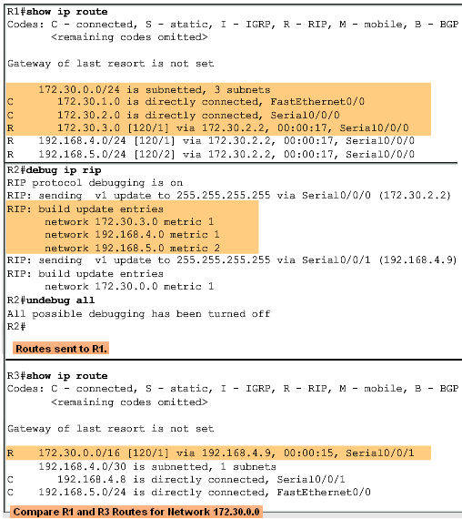
Automatic Summarization
Sending RIP Updates
  RIP uses automatic summarization to reduce the size of a routing table.

Slide 21
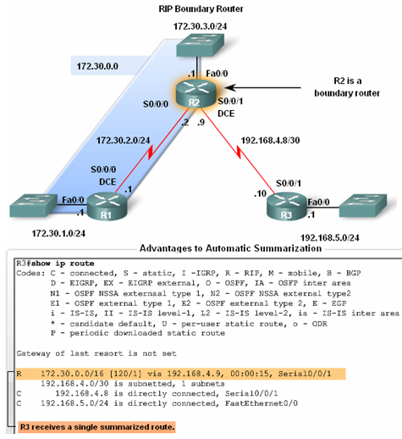
Automatic Summarization
Advantages of automatic summarization:
-The size of routing updates is reduced
-Single routes are used to represent multiple routes which results in faster lookup in the routing table.

Slide 22
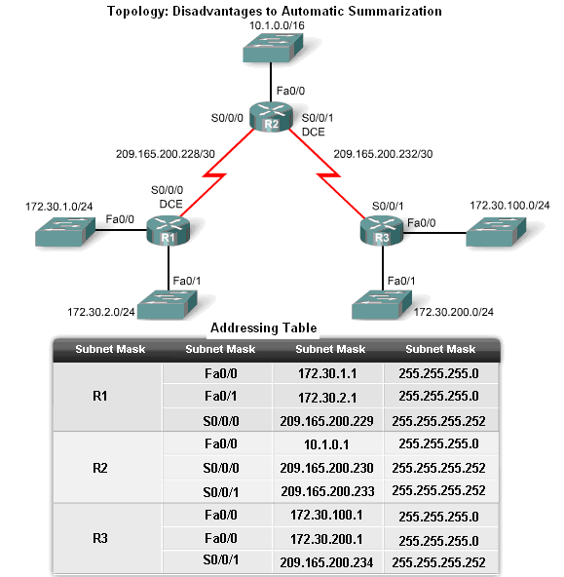
Automatic Summarization
Disadvantage of Automatic Summarization:
-Does not support discontiguous networks

Slide 23
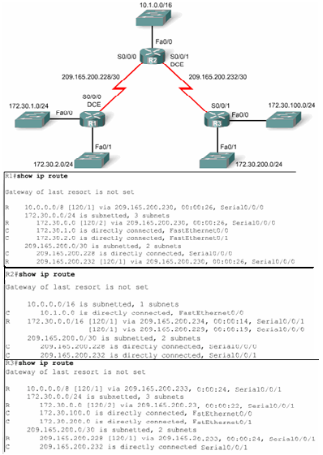
Automatic Summarization
Discontiguous Topologies do not converge with RIPv1
A router will only advertise major network addresses out interfaces that do not belong to the advertised route.

Slide 24
Default Route and RIPv1
Modified Topology: Scenario C
Default routes
  Packets that are not defined specifically in a routing table will go to the specified interface for the default route
  Example: Customer routers use default routes to connect to an ISP router.
  Command used to configure a default route is
  ip route 0.0.0.0 0.0.0.0 s0/0/1

Slide 25
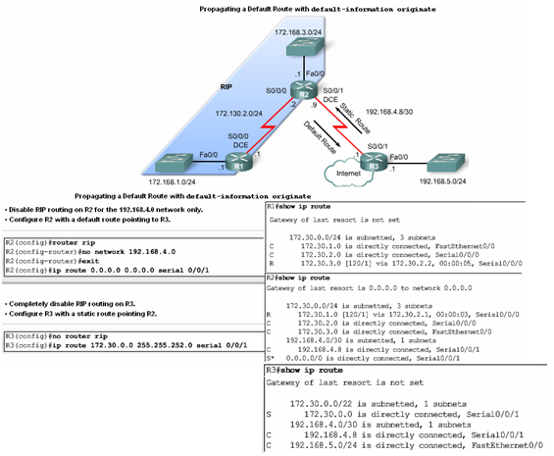
Default Route and RIPv1

Slide 26
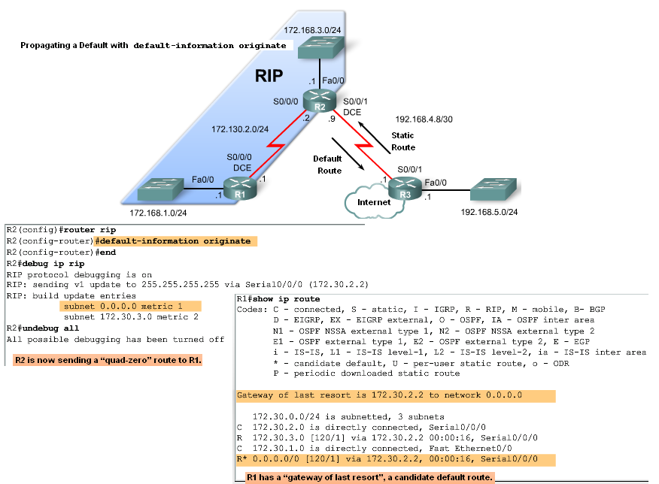
Default Route and RIPv1
Propagating the Default Route in RIPv1
Default-information originate command
  -This command is used to specify that the router is to originate default information, by propagating the static default route in RIP update.

Slide 27
Summary
RIP characteristics include:
Classful, distance vector routing protocol
Metric is Hop Count
Does not support VLSM or discontiguous subnets
Updates every 30 seconds
Rip messages are encapsulated in a UDP segment with source and destination ports of 520

Slide 28
Summary: Commands used by RIP
Command | Command’s purpose
Rtr(config)#router rip | Enables RIP routing process
Rtr(config-router)#network | Associates a network with a RIP routing process
Rtr#debug ip rip | used to view real time RIP routing updates
Rtr(config-router)#passive-interface fa0/0 | Prevent RIP updates from going out an interface
Rtr(config-router)#default-information originate | Used by RIP to propagate default routes
Rtr#show ip protocols | Used to display timers used by RIP

